Slide 1
Oct 25th
Xiangyang Shi
Trumpet~

Slide 2
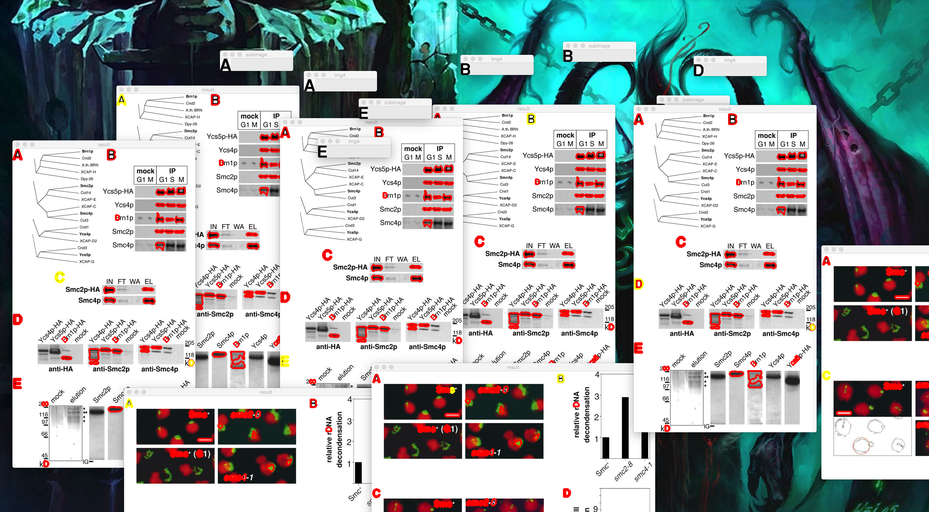
preview

Slide 3
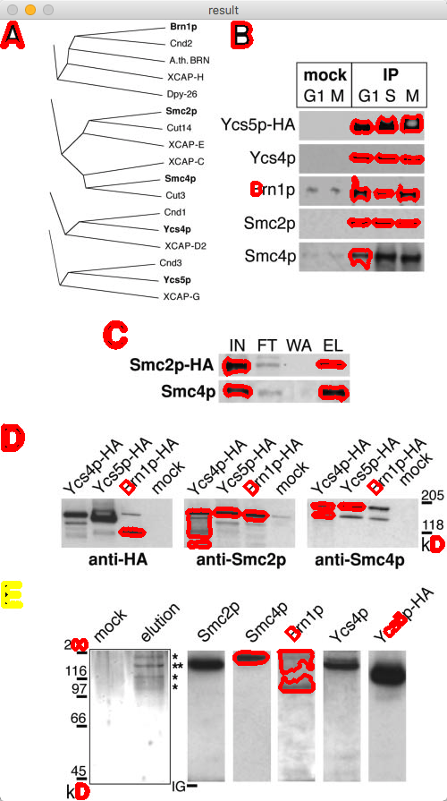
preview

Slide 4
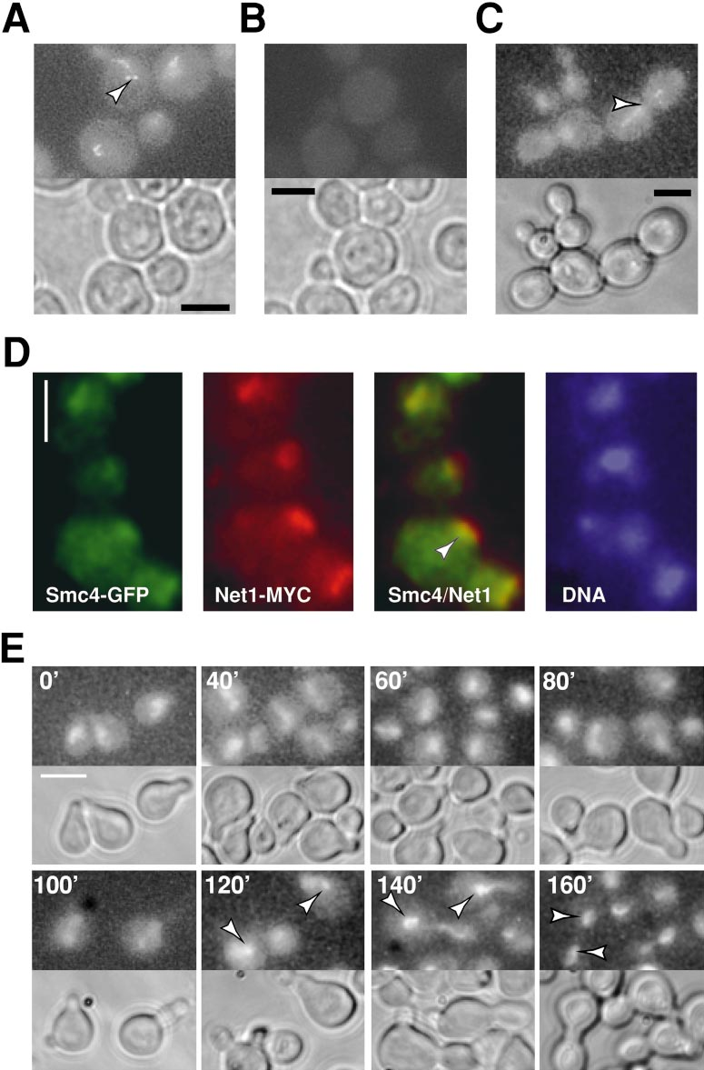
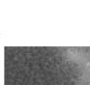

Moving
Window
method
Similarity score : 70%
Similarity score : 10%

Slide 5
Moving window method(last week)
Compare (Y_max – Ya_max) * (Xpixel – Xa_max) times
Each time compare Ya_max * Xa_max pixels
Too slow (34s per image)
So we have to sample the image
Too high sample rate results “A”being too vague to tell
=> Low performance

Slide 6
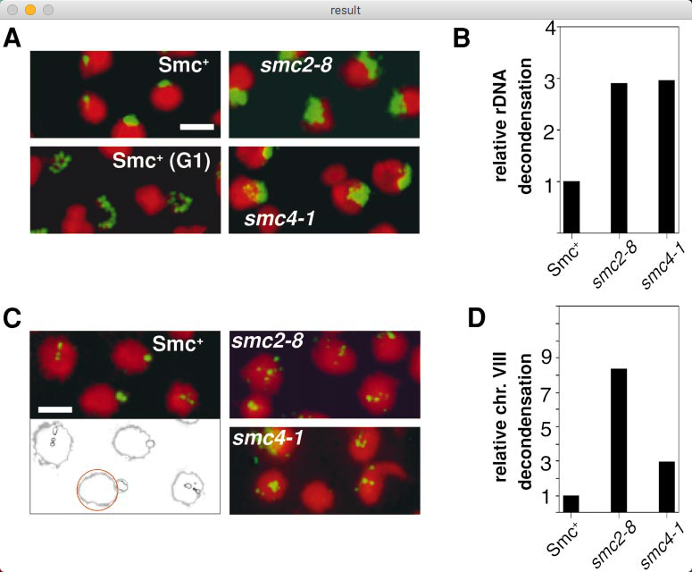
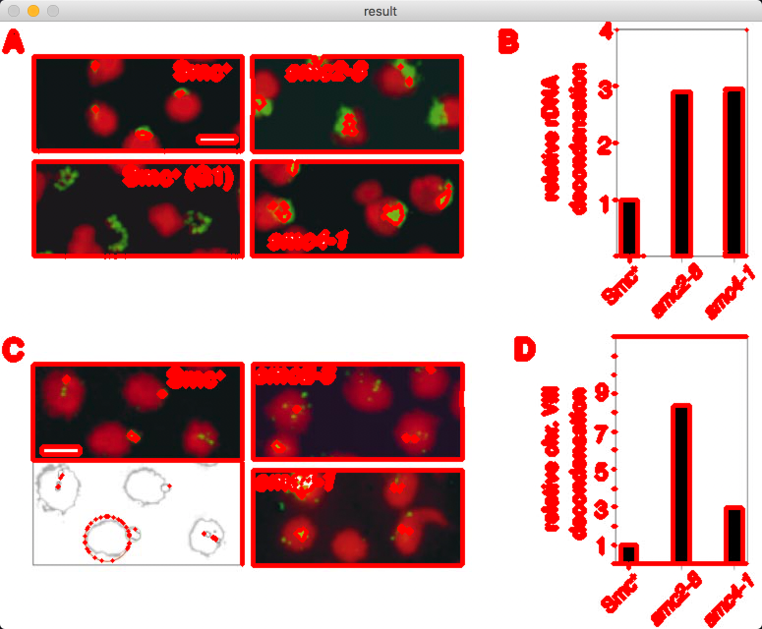
New method: Connected component

Slide 7
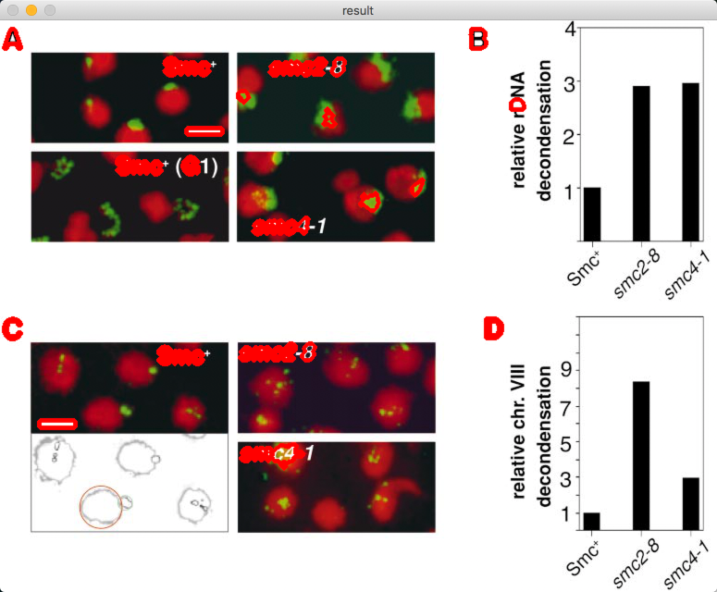
Connected component
Too many small areas
Reduce the nominated region by counting the area of pixels
Area > 100
Area < 1000

Slide 8
Draw bouding box
And then compare to the target “A”
One by one
The time complexity are reduced from
X*Y*x*y to x*y*Num(boxes)
The efficiency also improve the accuracy

Slide 9
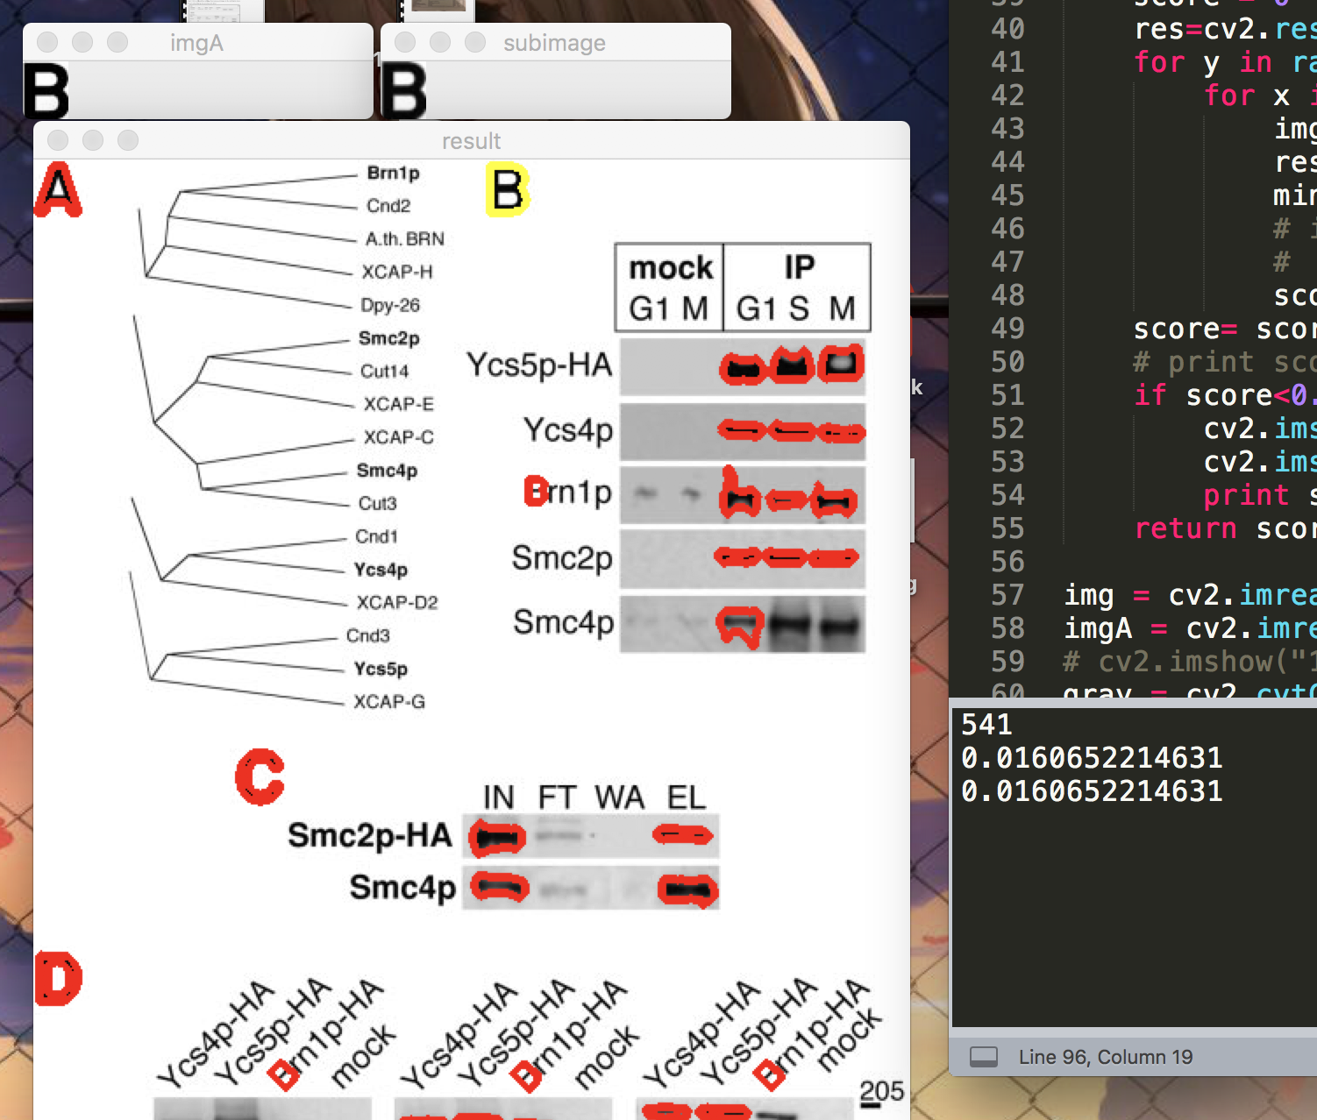
result
“B”I draw myself
“B”cutted from the whole image
The accuracy is much higher
I don’t finish embedding this method to the previous alg
With more adjustment, it can works
Num of nominate boxes
Wrong rate(distance between pixels from 2 Bs)

Slide 10

discussion
Rex wants me to use fast-CNN to train a model to find out borders of subimage.
Because that’s how human find out subimage
I think it not necessary
I’ve no idea until now how to train that model
Takes time to train and obtain dataset
I’m not sure how is the performance
Too much extreme situation, CNN will be hard to find out what’s wrong

Slide 11
discussion
I don’t use OCR programmed by Ray Smith
…
Hard to intercept the intermediate data (coordinate positions) during the OCR process
My alg is naïve but fast

